Slide 1
Introduction of Cyber Security in the phases of smart waste management systems
Research Proposal Presentation

Slide 2

Introduction
Waste management and disposal systems are classified as critical infrastructure
It plays a fundamental role in environmental protection by allowing sustainable and ecological disposal of waste.
Rapid urbanisation challenge infrastructures to look for scalable solutions that are required to be:
Dynamic
Economical
Reliable
Sustainable
Transparent
Learnings from Smart Cities identifies IoT technology as a credible solution.
Notes:
Various countries classify waste management and disposal systems as critical infrastructure due to its direct implication on the general health of the citizens (Novikovas and Stankevičius, 2018).
A waste management system plays an important role in allowing sustainable and ecological disposal of waste while protecting the environment. Rapid migration of population to urban cities is challenging the city’s limited infrastructure.
This demands for more scalable solutions that are deemed to be more dynamic, economic, reliable, sustainable, and transparent.
Detailed study and experience from designing smart cities identifies IoT technology as a credible solution (Fazio et al., 2012).
A well-designed IoT solution can not only fulfil the above requirements, but could also be integrated with the existing waste management systems with minimal disturbance.

Slide 3
Introduction (Continued)
IoT based implementation increases the attack surface due to the number of devices connected.
Cyber attack on the IoT based waste management can disrupt of daily routine of citizens by causing :
Cross contamination of waste
Water, air and ground pollution
Even data breach causing
Scavenging PII from paper trails
Extract information from old/used gadgets
Fabricate social engineering attacks
Unauthorized to sensitive records
Notes:
But introduction of sensor based solutions comes at the cost of security. IoT based solutions increases the attack surface considerably due to the number of devices that are required to be connected to the infrastructure. Cybercriminals have been increasingly targeting IoT devices and gadgets in recent years primarily due to spread of devices, constrained requirement that include limited power supply, processing capabilities. Moreover, recurrent duty cycles need for charging, firmware upgrade and uncontrollable product development life cycles of the equipment manufacturers (Coker, 2021).
Any manipulation in even one of these widespread devices will compromise the security of the whole network infrastructure it is connected to. Cyber-attack on waste management can disrupt the daily routine of the citizens and even cause environmental hazard in the form of cross contamination of waste, various types of pollution. Furthermore, a compromised IoT based waste management can leak personal information that can be used for social engineering attacks and gain unauthorized access to sensitive information.
Hence, Government of UK as formally passed a bill Product Security and Telecommunications Infrastructure (PSTI) Bill, which enforces security consideration for both the products/equipment being used and the infrastructure implementation of security in waste management systems.

Slide 4
Research Problem
Lack of understanding of the risks these technologies bring at the community level include:
Large attack surface due to the number of devices required.
Limited processing power and resources (battery, charge, processing)
Require uninterrupted connectivity to control centre.
Provisions for manual override in case of malfunction.
Protection against/hacking.
Difficult to service/upgrade once deployed.
Hence, we propose to test a prospective taxonomy that identifies areas to exercise idea of "security by design”, by inculcating security in very phases of waste management system.
Collection
Transportation
Disposal.
Notes:
Lack of understanding of the risks these technologies bring at the community level owing to.
The increased attack se attack surface due to the number of devices required.
Limited processing power and resources available on the sensors (battery, charge, processing)
Nonnegotiable requirement of uninterrupted connectivity to the command-and-control center.
Provisions for manual override in case of malfunction or hacking.
Difficult to service/upgrade once deployed.
Hence, we propose to test a prospective taxonomy that identifies areas to exercise idea of "security by design”, by inculcating security in very phases of waste management system.
Collection
Transportation
Disposal.

Slide 5
Research Question
How can we introduce an added layer of security to the existing infrastructure of IoT based waste management systems while considering the real-world challenges that can influence their implementation?
While abstaining any increase in the number of devices or security overheads for the people on the ground.
Notes:
Our research question focuses on “How can we introduce an added layer of security to the existing infrastructure of IoT based waste management systems while considering the real-world challenges that can influence their implementation?”
Without increasing the number of devices or security overheads for the people on the ground.

Slide 6
Literature review
Smart device industry is focused on cost effectiveness, efficiency, durability & production costs.
Sensors can be used in multiple configurations and settings
IoT sensors rely on the telecommunications infrastructure to transmit the data.
Data generated by the sensors not only allow to understand the usage trends but serve as datasets to model to scale the critical infrastructure.
Cyber attacks targeting the critical infrastructure can directly impact the routine functioning of the society, ecological health, data privacy and worst even human life.
The potential cyberattacks to IoT based system along with the ways to mitigate them include:
Device Software Failure
Node Tampering Attack
Eavesdropping Attack
Malicious Code Injection
Unauthorized Access
Social Engineering Attack
Notes:
Speed of urbanisation has forced smart device industry to focus on optimizing efficiency, durability, production costs and meet the foreseeable volumes of IoT devices. The generic sensors including infrared sensors, thermometer, barometer, lidar can be used in multiple configurations and settings. The smart sensors interconnect with telecommunication infrastructure to transmit the reports, data and flag events like acknowledgment, anomalies, etc. The use cases can range from waste identification before collection to confirmation of incineration. Smart bin can signal the local authorities to indicate when they are more than 80% - 90% full and will soon require collection (Pankaj et al., 2015). The Rao et al. in their model propose monitoring of the smart bin levels achieved by ultrasonic sensors and information is transmitted wirelessly, the over the internet using Blynk platform which helps in achieving real time access of data(Rao et al., 2020). Data collected from these smart devices will allow in better understanding of the trends to help us improve the reliability of the system and scale in the later phases of rollout. The IoT based waste management using smart bins is an evolving technique that will help keep local authorities clean & healthy. Similarly for transportation with the use of weight sensor, fume detectors we can monitor the garbage, in transit. Cyber attacks targeting the critical infrastructure can directly impact the routine functioning of the society, ecological health, data privacy and worst even human life.
Author (Alladi et al., 2020) emphasizes the danger and potential risks posed by an IoT device & further its counter measures:
1. Device Software Failure: In this form of attack any underlying vulnerability in the device's software can be exploited.
countermeasure: regular software updates/patches (Kaspersky Lab Security Services., 2018)
2. Node Tampering Attack: in this attack, attacker gets the hold of physical device and tampers with its electronic circuit manually.
countermeasure: Tamper-resistant hardware primitives such as physically unclonable functions (PUFs) can be added to the chip. (Kumar et al., 2019
3. Eavesdropping Attack: also known as snooping attack, where theft of information occurs while network traffic flowing from an intended IoT device.
countermeasure: Enabling encrypted communication establish the privacy of other devices on the IoT network.
4. Malicious Code Injection: in this attack, malicious code is injected in the IoT device through the firmware/software vulnerability.
countermeasure: appropriate authentication mechanisms should be implemented from the beginning of the code's execution.(Arias et al., 2015)
5. Unauthorized Access: in an iOT device by exploiting both software & hardware vulnerabilities & carrying out brute force attack an attacker can acquire unauthorized access
countermeasure: to produce session keys, Randomizer should be used in place of static secure tokens
6. Social Engineering Attack: it's a kind of attack that largely relies on individuals personal & sensitive information.
countermeasure: don't share any personal/confidential information & two factor authentication.

Slide 7
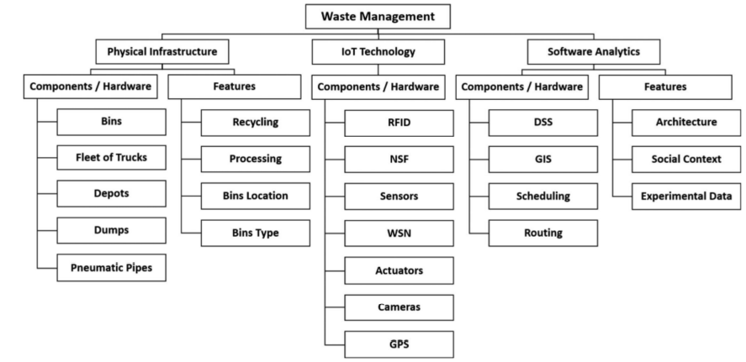
Literature review(Continued)
Notes:
Anagnostopoulos in his comprehensive survey studies the various waste management systems and smart devices in their respective settings(Anagnostopoulos et al., 2017). The survey proposed a fundamental classification that delineates the scope of:
1. Physical infrastructure
2. IoT Technology
3. Software analytics
This taxonomy served as a great starting point to comprehend the roles and responsibilities of the various devices. However, it wasn’t enough to identify possible gaps in the security realms. Hence identification of gaps required careful consideration the phases and steps involved in waste management systems from a security standpoint while considering real-world challenges.

Slide 8
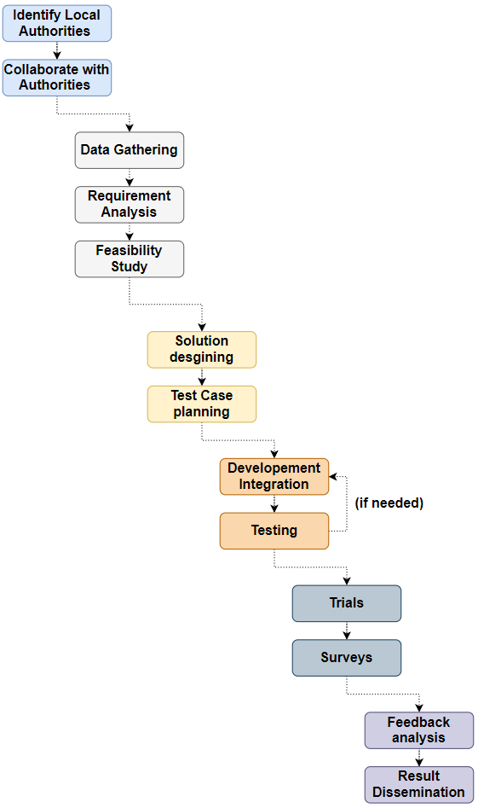
Research Methodology
Collaboration
Analysis
Designing & Planning
Development & Testing
Trials & Survey
Feedback analysis and Dissemination
Notes:
The research methodology is divided into 6 distinct parts, namely:
Collaboration
Analysis
Designing & Planning
Development & Testing
Trials & Survey
Feedback analysis and Dissemination
In London, Mayor decides strategies for waste management system but rely on the local authorities for waste management processes.
The local authorities are responsible for the processing of the collected waste from households, industries, commercial sites. Hence, we choose collaborate with the local authorities to understand the exisiting processes. This step helps in the analysis of their requirements while considering the best practices documented in the smart city studies.
We us the collected data to construct model and evaluate feasibility statistically and start with the solution designing and planning. Planning is accompanied by development and integration of prototypes which are tested against the requirements. After successful testing the solution will be offered for user trails for the operators followed by a detailed survey.
The survey along with chosen performance indicators will determine the success of the proposed taxonomy.

Slide 9
Significance of our Research
Relation between Security and environment.
Phased approach to introduce security.
Compromised endpoint is a compromised network.
Damages can range from to environment to loss of life in case of cross-contamination.
Our model's proposed advantages are as follows:
Ensures that all sites' areas are secure against Malicious Users or Waste Thieves.
Control access to the site for both personnel and visitors.
Monitor security cameras and intruder alerts.
Identification of trespassing incidents.
Transparency & Back-traceability from source to disposal.
Multi Level authentication not only for the devices but also the vehicles involved in the process of transportation.
Notes:
When it comes to the environment, waste management tops the list, making it one of the most pressing issues to handle. Moving forward in the digital age, security is something that cannot be overlooked.
Security and environment are the terms we rarely hear together. So, what do they both have in common? Well, there's a lot more to it than meets the eye. It is at the infrastructure level where the main cyber security threat exist. As previously mentioned, waste management is divided into three phases, each of which necessitates the use of smart bins and a collection network. All of this is infrastructure intensive and is all linked through command-and-control centres (C&C). Each center is run by a network of computers that are linked together, which in turn are vulnerable to a variety of security risks covering both ends of the spectrum from intrusion attacks to internal bad actors. This entire paradigm makes security a major concern for reliable waste management systems.
Bear in mind the increase in medical waste over the last two years, as well as its collection and disposal, it has become even more vital for the human population. As a result, a cybersecurity failure could pose a significant health risk. Hence, any security breach that jeopardizes public health would cost far more than just physical damage.
The model is built on the interrelationships of major factors affecting the collection, Transportation and disposal.
Our model's proposed advantages are as follows:
Ensures that all sites' areas are secure against :
Malicious Users
Waste Thieves
Control access to the site for both personnel and visitors.
Prevent probable waste pit fires before they start.
Monitor security cameras and intruder alerts.
Identification of trespassing incidents.
Transparency from Collection to Disposal
Backtracability from Collection to Disposal ( e.g., Radioactivity, etc)
Multi Level authentication not only for the user but also the vehicles involved in the process of transportation.

Slide 10
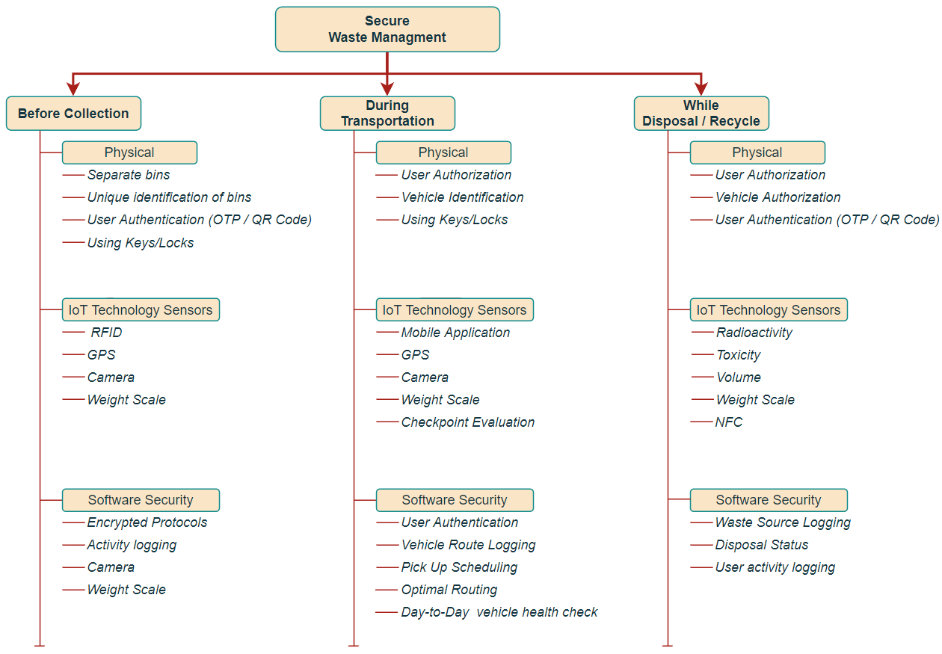
Proposed Taxonomy
The fundamental performance indicators of in research include:
User Security
Device/Sensor Security
Traceability
Re-use sensors to decrease e-waste
Seamless integration with infrastructure
Version Control for vulnerability tracking
Battery power overheads

Slide 11
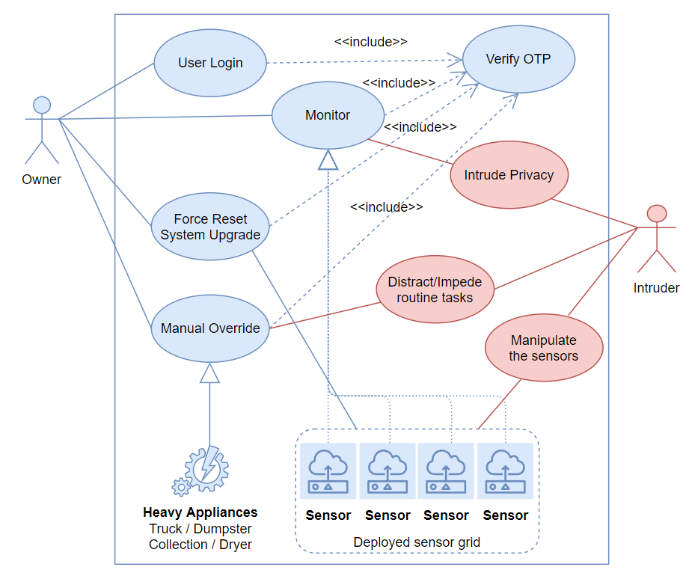
Proposed artefacts (Use Case)

Slide 12
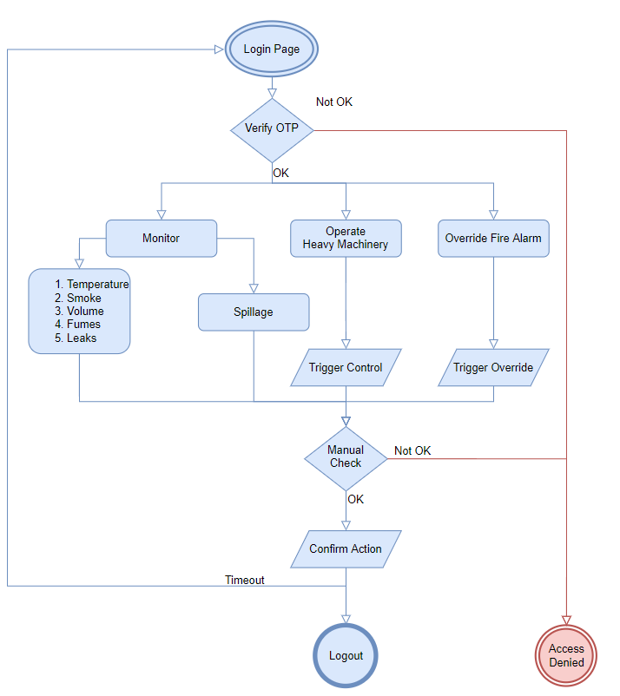
Proposed artefacts (In Transit)

Slide 13
Risk assessment
Rank | Risk Type | Risk of Occurrence | Impact Assessment | Mitigation plan
1 | Time Constraint | high | Severe | 1. Periodic scrum meeting for time alignment.
2 | Personal Data Security | Medium | Severe | 1. Conformity to Non-Disclosure agreements. 2. The Data used for statistical modelling will be anonymized .
3 | Technology unavailability | Low | Severe | 1. Align multiple vendors for sensory devices.
3 | Hardware shortage | high | Severe | 1. Align multiple vendors for chipsets and tools.
4 | Approval from Municipal autorithies | Low | Severe | 1. Applied for government authorization 2. Contact at least 3 borough council and ensure availability

Slide 14
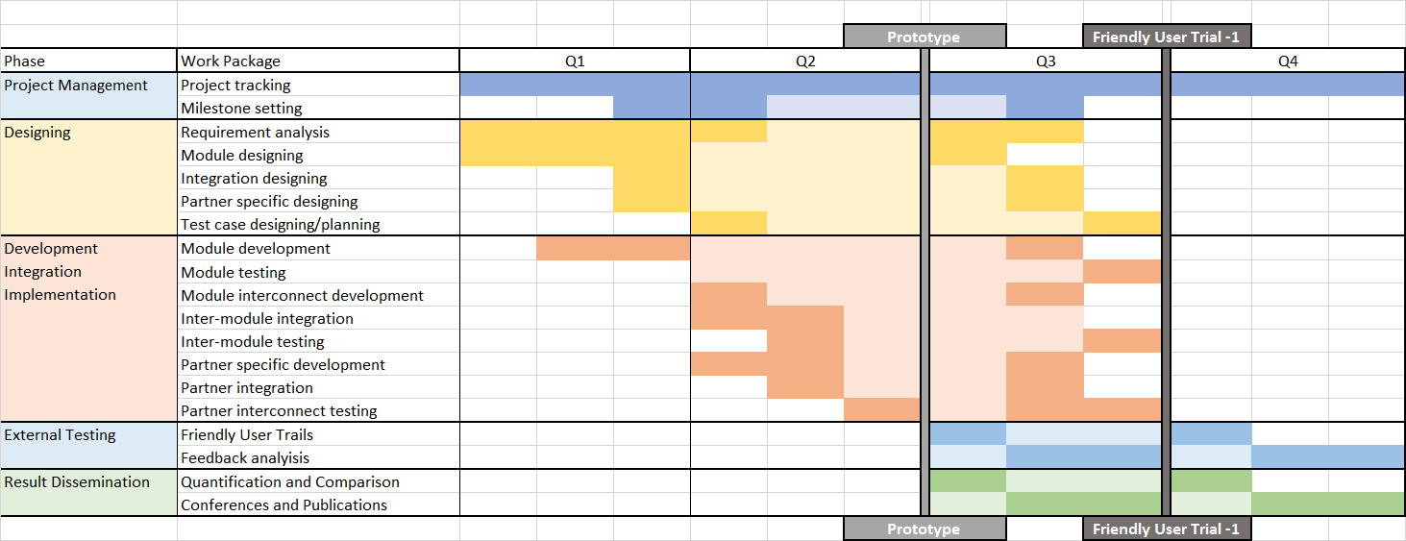
Research Time Plan (Gantt Chart)

Slide 15
References
Novikovas, A. and Stankevičius, A. (2018). MUNICIPAL WASTE, AS CRITICAL INFRASTRUCTURE, MANAGEMENT: CASE OF LITHUANIA. Journal of Security and Sustainability Issues, 8(2), pp.135–143.
Pankaj Morajkar, Vikrant Bhor, Pandya, D., Deshpande, A. and Maheshwar Gurav (2015). Smart Garbage Management System. International Journal of Engineering Research & Technology, [online] 4(3). Available at: https://www.ijert.org/smart-garbage-management-system [Accessed 4 Apr. 2022].
Alladi, T., Chamola, V., Sikdar, B. and Choo, K.-K.R. (2020). Consumer IoT: Security Vulnerability Case Studies and Solutions. IEEE Consumer Electronics Magazine, [online] 9(2), pp.17–25. Available at: https://ieeexplore.ieee.org/abstract/document/8977812/figures#figures [Accessed 3 Apr. 2022].
‌Kumar, S.K., Satheesh, N., Mahapatra, A., Sahoo, S. and Mahapatra, K.K. (2019). Physical Unclonable Functions for On-Chip Instrumentation: Enhancing the Security of the Internal Joint Test Action Group Network. IEEE Consumer Electronics Magazine, [online] 8(4), pp.62–66. Available at: https://ieeexplore.ieee.org/abstract/document/8732719 [Accessed 3 Apr. 2022]

Slide 16
References(Continued)
Kaspersky Lab Security Services", 2018, [online] Available: https://media.kasperskycontenthub.com/wp-content/uploads/sites/43/2018/ 12/13084354/ChargePoint-Home-security-research_final.pdf.
Arias, O., Wurm, J., Hoang, K. and Jin, Y. (2015). Privacy and Security in Internet of Things and Wearable Devices. IEEE Transactions on Multi-Scale Computing Systems, [online] 1(2), pp.99–109. Available at: https://ieeexplore.ieee.org/abstract/document/7321811 [Accessed 3 Apr. 2022].
Rao, P.V., Azeez, P.M.A., Peri, S.S., Kumar, V., Devi, R.S., Rengarajan, A., Thenmozhi, K. and Praveenkumar., P. (2020). IoT based Waste Management for Smart Cities. 2020 International Conference on Computer Communication and Informatics (ICCCI). [online] Available at: https://ieeexplore.ieee.org/abstract/document/9104069 [Accessed 3 Apr. 2022].

